Slide 1
SPARTA PLATFORM
EXL
SECURITY ARCHITECTURE
Security Architecture Diagram
High Level Design (Traffic Flow) & Chronological Workflow
INTERNAL DOCUMENT
© 2025 EXL Service Holdings, Inc. All rights reserved.
Notes:
SPARTA security architecture, rebuilt to follow the ISG-approved Security Architecture Diagram sample. Single Windows EC2 application host with S3, RDS MySQL, Bedrock Nova, GitHub and SES.

Slide 2
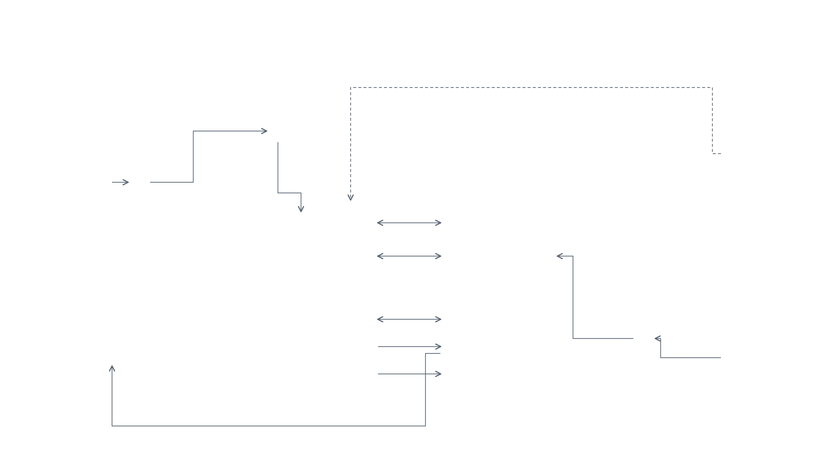
























High Level Design Diagram (Including Traffic Flow) — End to End Component Level
AWS Cloud · us-east-1
Production VPC 10.0.0.0/16
Deploy · CI/CD (HTTPS / SSH)
PUBLIC SUBNET
Security & Access Control
EXTERNAL
HTTPS · TLS 1.3
Applies across all components
CORPORATE LAPTOPS
Application Load Balancer
IAM Roles
Internal only · managed devices
Least-privilege access
Amazon Cognito
GitHub Source control · CI/CD
PRIVATE SUBNET · AZ-1
HTTPS
AuthN / AuthZ · MFA
Business Users SPARTA React App
Site-to-Site IPSEC VPN
AWS WAF
Edge protection
SPARTA Application Server
DB over SSL · TLS 1.3
DATA TIER
VPC Security Groups
Windows Server EC2 · single host
Amazon RDS (MySQL)
Network isolation
Admin Ops console
Structured data · encrypted
Secrets Manager
HOSTED ON THIS INSTANCE
HTTPS · TLS 1.3
Amazon S3
DB & API credentials
React Frontend
App & REST API
Data files · assumptions · output
Internal access only — corporate-managed laptops, no public internet
AWS KMS
Calculation Engine
Actuarial Scripts
Encryption keys
ETL & Data Conv.
Comparison Tool
TLS 1.3 in-transit · AES-256 at-rest
AI & MANAGED SERVICES · via VPC endpoints
Vendor files → S3
Encrypted EBS volume · AES-256 at rest
Bedrock API · TLS 1.3
EXTERNAL
Amazon Bedrock (Nova)
SMTP · TLS
GenAI — scripts, SQL, ETL assist
Amazon SES
AWS Transfer for SFTP
Mail Recipients Business mailbox group
Outbound mail service
SFTP over TLS
Logs · TLS
Amazon CloudWatch
Upstream Data Source Vendor SFTP files
Logs · metrics · alarms
Email notifications · SMTP over TLS
INTERNAL DOCUMENT
© 2025 EXL Service Holdings, Inc. All rights reserved.
EXL
Notes:
End-to-end component diagram. Internal corporate users reach the SPARTA React app through the WAF and Application Load Balancer into the private subnet. A single Windows EC2 hosts the frontend, API, calculation engine, actuarial scripts, ETL and comparison tool. It talks to RDS MySQL and S3 for data, Bedrock Nova for GenAI, SES for mail, CloudWatch for logs. GitHub deploys via CI/CD. Security and access control apply across all components.

Slide 3
Workflow — Chronological Order
How a SPARTA valuation run flows through the platform, step by step
Step #
Step Name
Description
From
To
Sample Fields
1
DeployRelease
CI/CD pipeline builds the SPARTA app and deploys the release to the Windows EC2 host.
GitHub
Windows EC2
build artifact, release tag, commit SHA
2
IngestData
Upstream vendor files arrive over SFTP via AWS Transfer and land in S3 for processing.
Upstream Data Source
AWS Transfer (SFTP) → S3
vendor_extract.txt, PGP-encrypted
3
UserLogin
User opens the SPARTA React app and authenticates with MFA.
User Browser
Amazon Cognito
username, MFA token, JWT
4
SubmitRun
Authenticated user submits a valuation run (product + assumptions).
User Browser
SPARTA App (EC2)
product_id, assumption_set, val_date
5
LoadSourceData
App loads policy & assumption files from S3 and reference data from RDS.
SPARTA App (EC2)
Amazon S3 · RDS MySQL
policy_extract.csv, assumptions.json
6
ValidateInputs
App validates product config, assumptions and data completeness.
SPARTA App (EC2)
SPARTA App (EC2)
validation rules, error_log
7
GenerateScripts
Engine calls Bedrock (Nova) to generate actuarial scripts & SQL queries.
SPARTA App (EC2)
Amazon Bedrock (Nova)
model=amazon.nova, script.py, query.sql
8
RunCalculation
Calculation Engine runs valuation models in-process on the EC2.
SPARTA App (EC2)
SPARTA App (EC2)
run_id, model A / B / N
9
PersistResults
Structured results written to RDS; output extracts written to S3.
SPARTA App (EC2)
RDS MySQL · Amazon S3
results table, results_{run_id}.csv
10
CompareVsLegacy
Comparison Tool checks SPARTA output against the legacy baseline.
SPARTA App (EC2)
Amazon S3 · RDS
variance_report.xlsx, diff summary
11
EmailResults
Run summary & variance report emailed to the business mailbox group.
SPARTA App (EC2)
Amazon SES → Users
run summary, report link, status
INTERNAL DOCUMENT
© 2025 EXL Service Holdings, Inc. All rights reserved.
EXL
Notes:
Chronological workflow: GitHub deploys to EC2; user logs in via Cognito; submits a run; the app loads data from S3 and RDS, validates, calls Bedrock Nova to generate scripts, runs the calculation engine, persists results to RDS and S3, compares against legacy, and emails results via SES.

